Slide 1



Data Model, Leon, Gabriela
View in Power BI
Last data refresh:
10/21/2022 1:37:06 AM UTC
Downloaded at:
1/7/2023 6:42:44 PM UTC

Slide 2
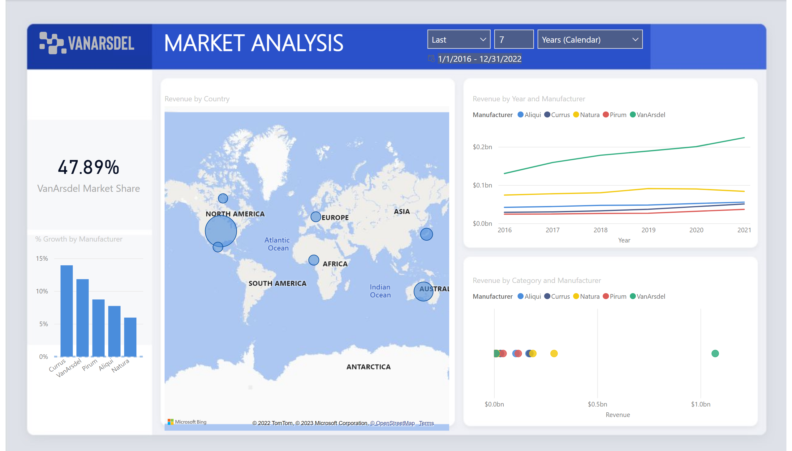
Market Share
Notes:
image
No alt text provided
textbox
No alt text provided
slicer
No alt text provided
slicer
No alt text provided
lineChart
No alt text provided
map
No alt text provided
card
No alt text provided
columnChart
No alt text provided
scatterChart
No alt text provided

Slide 3
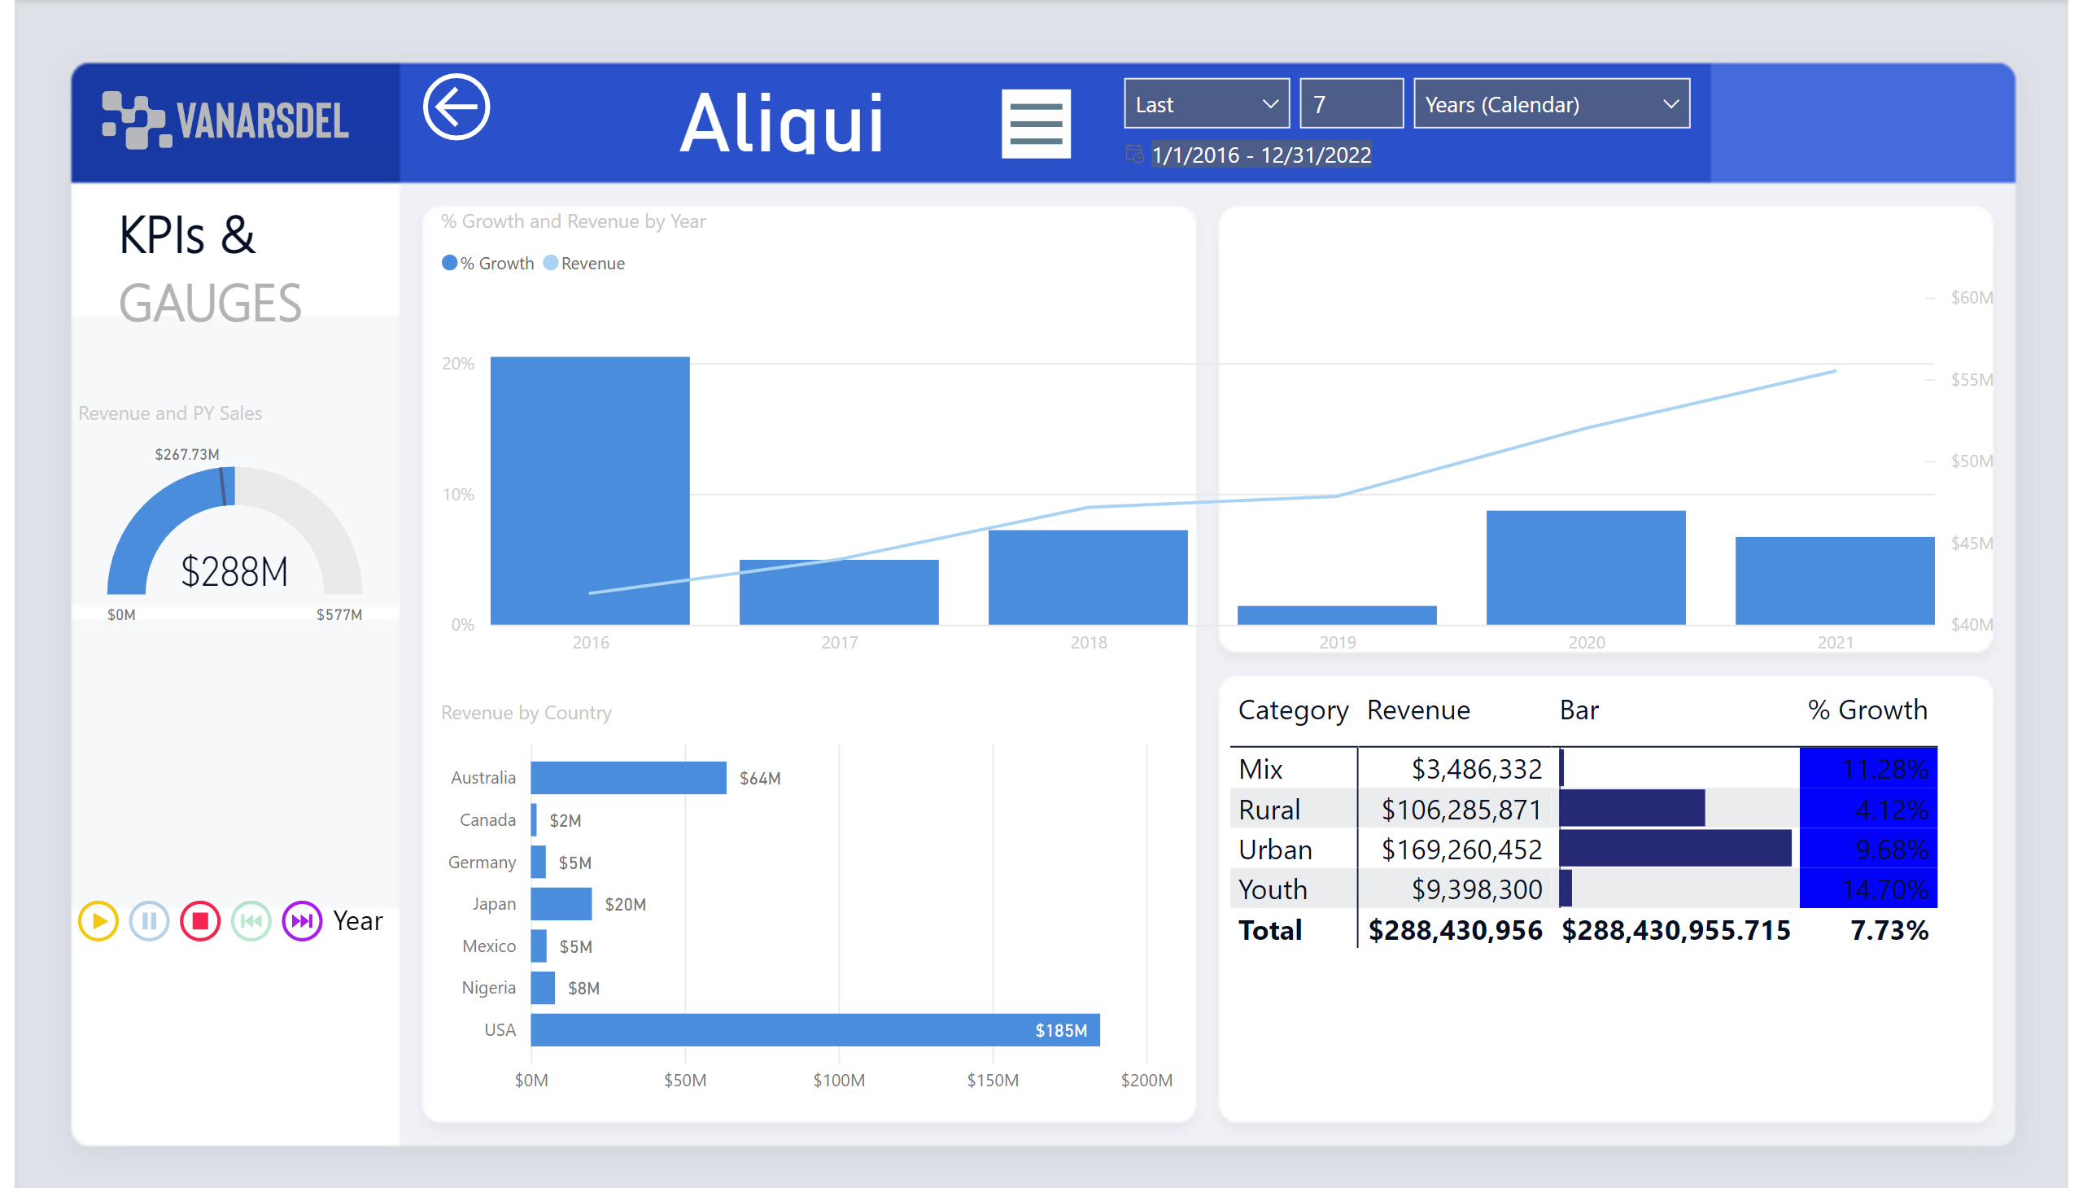
Manufacturer
Notes:
image
No alt text provided
slicer
No alt text provided
actionButton
No alt text provided
image
No alt text provided
image
No alt text provided
textbox
No alt text provided
gauge
No alt text provided
PBI_CV_16948668_E17D_454B_8664_2F2C470EA8C1
No alt text provided
card
No alt text provided
barChart
No alt text provided
pivotTable
No alt text provided
lineClusteredColumnComboChart
No alt text provided
slicer
No alt text provided

